Slide 1
Limit Equilibrium Procedures Part 2
CE 544 – BRIGHAM YOUNG UNIVERSITY

Slide 2
General Method of Slices
Unknowns:
1 factor of safety
n values of N
n locations for N
n-1 values of E
n-1 values of X
n-1 locations for E
Total: 5n-2
Equilibrium Equations:
n equations for ΣF_{v}=0
n equations for ΣF_{H}=0
n equations for ΣM=0
Total: 3n
5n-2 > 3n, therefore statically indeterminate
S = f(c’,φ’,u,N,F,Δl)

Slide 3
General Method of Slices
Note: side forces can be represented by magnitude and direction. Same number of equations and unknowns.

Slide 4
General Method of Slices
Several techniques based on method of slices
Each technique uses a different set of assumptions to reduce # of unknowns
Some techniques satisfy complete equilibrium
2n-2 assumptions
3n equations satisfied
Some don’t satisfy equilibrium
>2n-2 assumptions
<3n equations satisfied

Slide 5
Ordinary Method of Slices

Slide 6

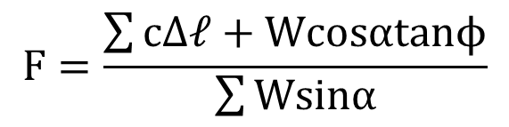
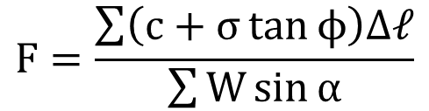
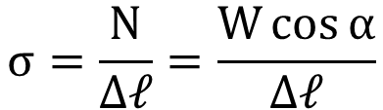
Ordinary Method of Slices (OMS)
Key assumption → Side forces can be neglected (i.e., sum to zero on each slice)
Σ Forces perpendicular to base of slice:
$$N=Wcosα$$
$$σ=\frac{N}{∆ℓ}=\frac{W\cos{α}}{∆ℓ}$$
General equation:
$$F=\frac{\sum{\left(c+σ\tan{ϕ}\right)∆ℓ}}{\sum{W\sin{α}}}$$
Substituting σ:
$$F=\frac{\sum{cΔ𝓁+Wcosαtanϕ}}{\sum{Wsinα}}$$
Notes:
Some of these equations have been converted to MS OFFICE equation format. I had a problem with the lower case L displaying properly. Would like to switch everything to MS Office format eventually.

Slide 7
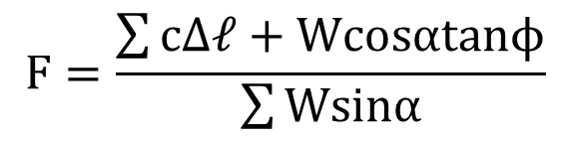
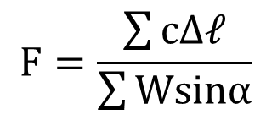
Ordinary Method of Slices
If φ = 0:
0
$$F=\frac{\sum{cΔ𝓁+Wcosαtanϕ}}{\sum{Wsinα}}$$
$$F=\frac{\sum{cΔ𝓁}}{\sum{Wsinα}}$$
← This is the same solution we found earlier for the generalized method

Slide 8
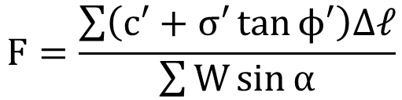
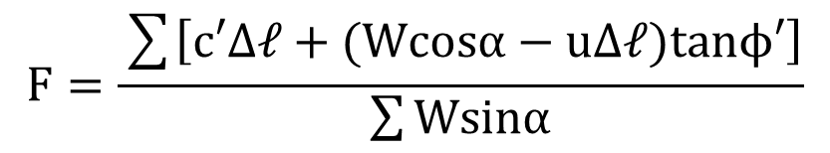
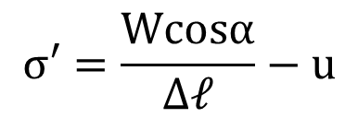
Ordinary Method of Slices
For effective stress analysis:
$$F=\frac{\sum{\left(c′+σ′\tan{ϕ′}\right)∆ℓ}}{\sum{W\sin{α}}}$$
$$σ′=\frac{Wcosα}{Δ𝓁}−u$$
$$F=\frac{\sum{\left[c′Δ𝓁+(Wcosα−uΔ𝓁)tanϕ′\right]}}{\sum{Wsinα}}$$
← This equation can lead to unrealistically low or even negative effective stresses (unconservative)

Slide 9




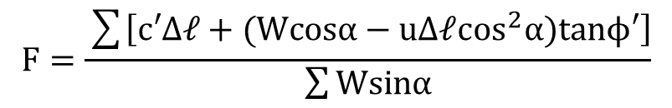

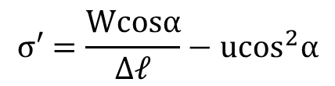

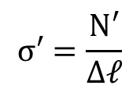
Ordinary Method of Slices
Alternate Formulation
$$σ′=\frac{N′}{Δ𝓁}$$
Define vertical effective weight:
$$σ′=\frac{Wcosα}{Δ𝓁}−u\cos^{2}α$$
$$W′=W−ub$$
Σ forces perpendicular to base:
Substituting:
$$N′=W′cosα$$
$$F=\frac{\sum{\left[c′Δ𝓁+(Wcosα−uΔ𝓁\cos^{2}α)tanϕ′\right]}}{\sum{Wsinα}}$$
$$N′=(W−ub)cosα$$
$$N′=Wcosα−ubcosα$$
$$b=Δ𝓁cosα$$
This is the preferred formulation for OMS
$$N′=Wcosα−uΔ𝓁\cos^{2}α$$

Slide 10
Summary - OMS
Circular shear surface
Only satisfies moment equilibrium
For φ=0, OMS gives the same solution as the Swedish method
F can be calculated directly, without iteration
Less accurate than other procedures of slices

Slide 11
Simplified Bishop’s Method

Slide 12
Simplified Bishop’s Method
Simplifying assumption:
Side forces are horizontal. I.e., vertical side force components (X_{i}, X_{i+1}) are equal to zero.

Slide 13

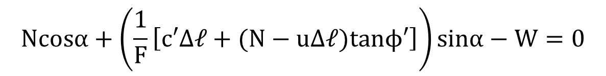
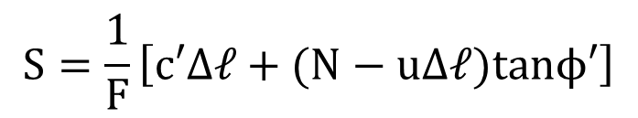
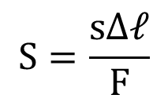

Simplified Bishop’s Method
Σ forces in the vertical direction:
$$Ncosα+Ssinα−W=0$$
$$S=τΔ𝓁$$
$$S=\frac{sΔ𝓁}{F}$$
$$S=\frac{1}{F}\left[c′Δ𝓁+(N−uΔ𝓁)tanϕ′\right]$$
Substituting:
$$Ncosα+\left(\frac{1}{F}\left[c′Δ𝓁+(N−uΔ𝓁)tanϕ′\right]\right)sinα−W=0$$

Slide 14
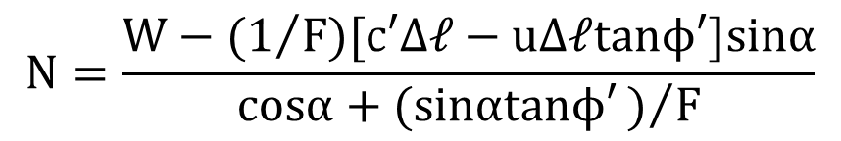
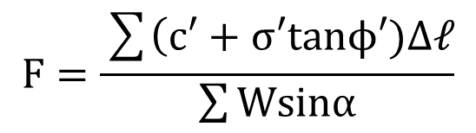
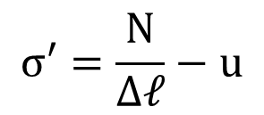
Simplified Bishop’s Method
Solving for N:
$$N=\frac{W−(1/F)[c′Δ𝓁−uΔ𝓁tanϕ′]sinα}{cosα+(sinαtanϕ′)/F}$$
$$σ′=\frac{N}{Δ𝓁}−u$$
From general equation (based on moment equilibrium):
$$F=\frac{\sum{\left(c′+σ′tanϕ′)Δ𝓁\right.}}{\sum{Wsinα}}$$

Slide 15
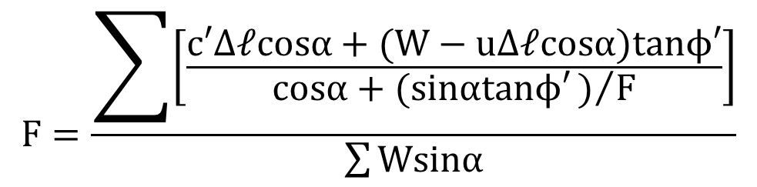
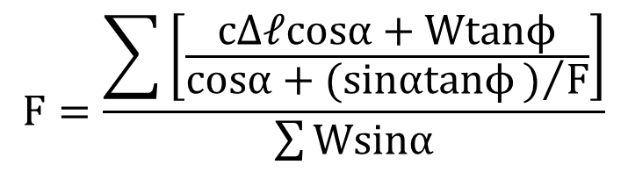
Simplified Bishop’s Method
Combining the three previous equations and solving for F:
$$F=\frac{\sum{\left[\frac{c′Δ𝓁cosα+(W−uΔ𝓁cosα)tanϕ′}{cosα+(sinαtanϕ′)/F}\right]}}{\sum{Wsinα}}$$
Note that F is on both sides. Must be solved iteratively.
For total stress analysis:
$$F=\frac{\sum{\left[\frac{cΔ𝓁cosα+Wtanϕ}{cosα+(sinαtanϕ)/F}\right]}}{\sum{Wsinα}}$$

Slide 16
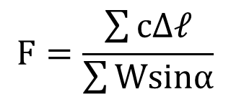
Simplified Bishop’s Method
For φ=0, equation reduces to:
$$F=\frac{\sum{cΔ𝓁}}{\sum{Wsinα}}$$
Which is the same equation derived for log spiral, Swedish method, and OMS

Slide 17
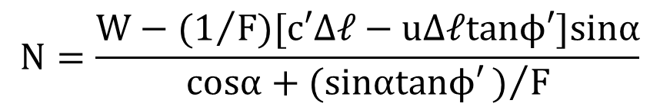
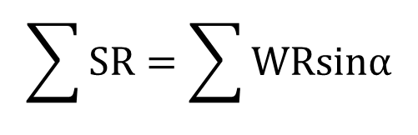

Simplified Bishop’s Method
Once F is found, N can be computed as:
$$N=\frac{W−(1/F)[c′Δ𝓁−uΔ𝓁tanϕ′]sinα}{cosα+(sinαtanϕ′)/F}$$
For OMS:
$$N=Wcosα$$
Difference in solution is due to differences in N. Both use the same overall equation:
$$\sum{SR}=\sum{WRsinα}$$

Slide 18
Summary – Simplified Bishop’s
Unknowns:
n normal forces along base of slice
1 factor of safety
Total: n+1
Equilibrium Equations:
n equations for ΣF_{v}=0
1 equation for overall ΣM=0
Total: n+1

Slide 19
Summary – Simplified Bishop’s
Circular slip surface
Horizontal side forces
Satisfies
Moment equilibrium
Force equilibrium in vertical direction
More accurate than OMS, especially for effective stress analysis with high pore pressures

Slide 20
Bishop’s Complete Equilibrium Procedure
Similar to simplified procedure except it is not assumed that all (X_{i+1} – X_{i}) = 0.
A set of values for vertical side forces is assumed and vertical and horizontal force equilibrium is checked. Process is repeated until equilibrium is satisfied.
Time-consuming and complicated

Slide 21
Force Equilibrium Procedures

Slide 22
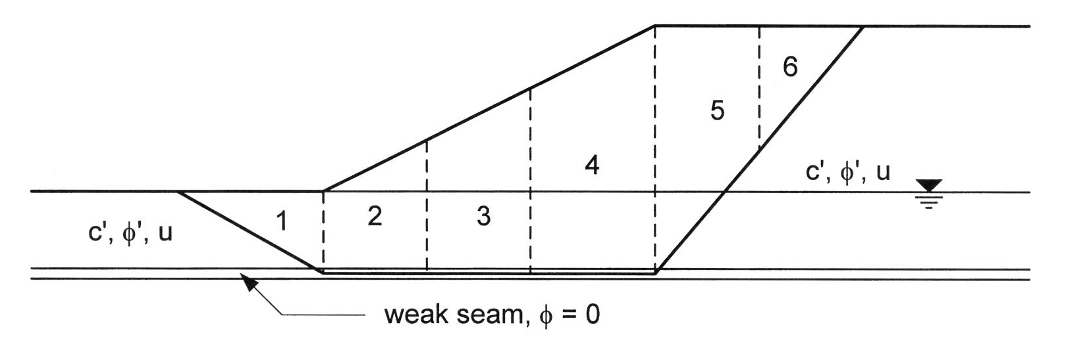
Force Equilibrium Procedures
Can be used on non-circular surfaces
No attempt is made to satisfy moment equilibrium

Slide 23
Force Equilibrium Procedures
Unknowns:
1 factor of safety
n values of N
n-1 values of Z
n-1 values of θ
Since we are not satisfying moment equilibrium, locations no longer matter
Total: 3n-1
Equilibrium Equations:
n equations for ΣF_{v}=0
n equations for ΣF_{H}=0
Total: 2n
3n-1 > 2n, therefore n-1 assumptions necessary
Best strategy is to assume n-1 values of θ

Slide 24
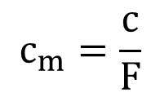
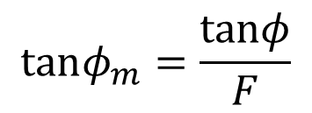
Force Equilibrium Procedures
Procedure
(1) Assume F, compute:
$$c_{m}=\frac{c}{F}$$
$$tanφ_{m}=\frac{tanφ}{F}$$

Slide 25
Force Equilibrium Procedures
(2) Start on slice #1. Solve for N and Z by satisfying ΣFx=0 and ΣFy=0.

Slide 26
Force Equilibrium Procedures
(3) Repeat for each of the slices in sequence:

Slide 27
Force Equilibrium Procedures
(4) Forces should balance on the last slice:
2 equations
1 unknown
If forces do not balance, try a new F and repeat steps 2-4

Slide 28
Side Force Assumptions
Lowe and Karafaith
For each slice, use average slope of ground surface and slip surface
Simplified Janbu
The side forces are assumed to be horizontal
U.S. Army Corps of Engineers
Parallel to slope (see next slide)

Slide 29
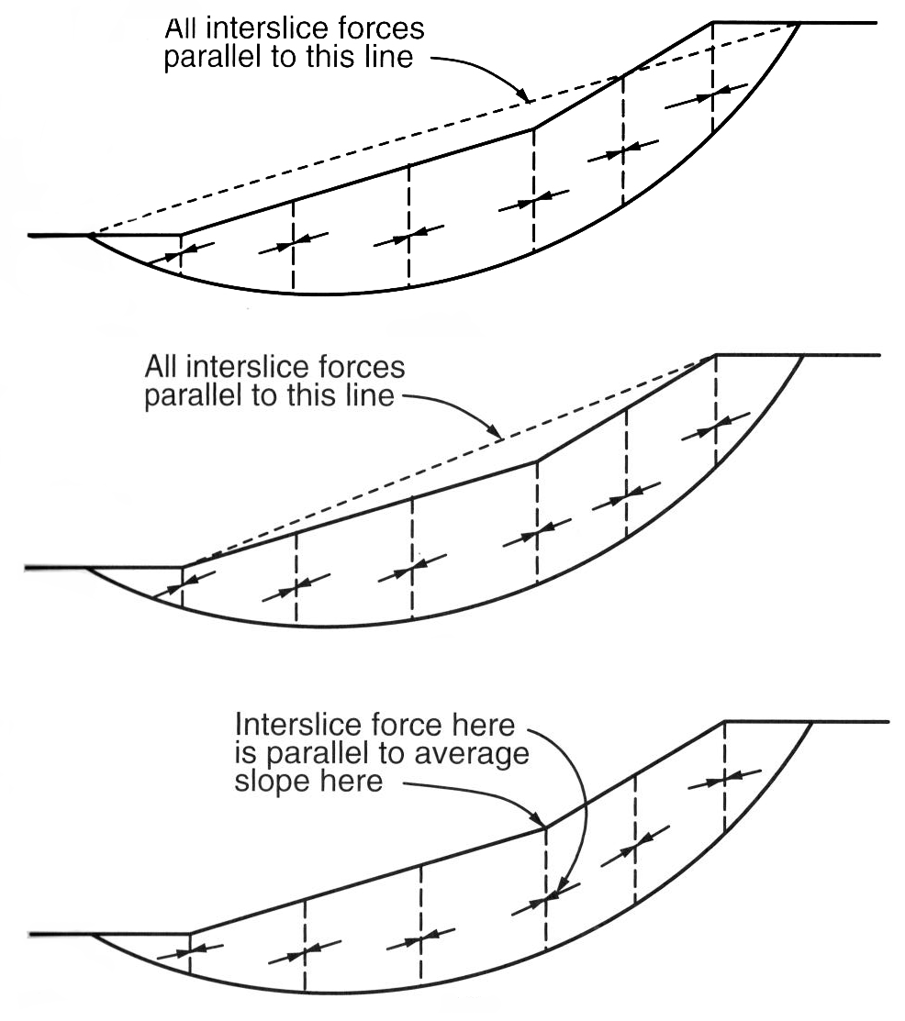
Side Force Assumptions, Cont.
U.S. Army Corps of Engineers
“Modified Swedish Procedure”

Slide 30
Summary – Force Equilibrium Methods
Works on both circular and non-circular surfaces
Satisfies force equilibrium only, not moment equilibrium
Requires iteration
Key assumption = side force inclinations

Slide 31
Complete Equilibrium Procedures

Slide 32
Complete Equilibrium Procedures
Unknowns:
1 factor of safety
n values of N
n-1 values of E
n-1 values of X
n locations for N
n-1 locations for E
Equilibrium Equations:
n equations for ΣF_{v}=0
n equations for ΣF_{H}=0
n equations for ΣM=0
Total: 3n
Total: 5n-2
We need 2n-2 assumptions to make the problem statically determinate
Assume n locations of normal forces, N (middle of slice). This leaves n-2 assumptions still required

Slide 33
Spencer’s Method
Simplifying assumption:
All side forces are parallel. (θ=constant)
Unknowns:
1 factor of safety
n values of N
n-1 values of Z
1 side force inclination θ
n-1 locations of Z
Total: 3n

Slide 34
Spencer’s Method
Side forces Z_{i} and Z_{i+1} are combined into a single resultant side force Q_{i}, acting at an angle = θ.

Slide 35
Spencer’s Method
He also assumed that W,S, and N all act through the same point b (center of the bottom of the slice)
Therefore, Q_{i} must also act through the same point b in order to maintain moment equilibrium

Slide 36
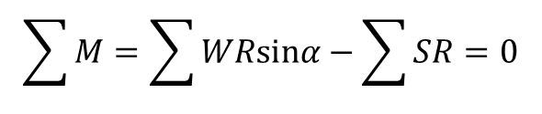
Spencer’s Method
For overall moment equilibrium:
$$\sum{M}=\sum{WRsinα}−\sum{SR=0}$$
(same as before)

Slide 37
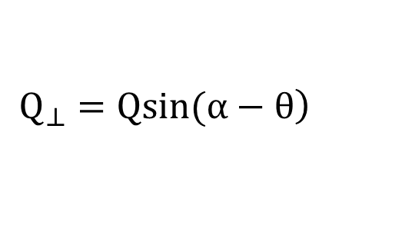
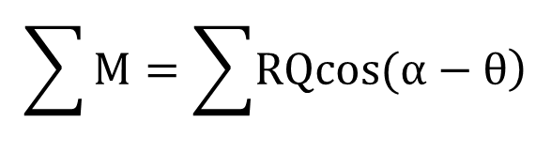

Spencer’s Method
Two components of Q:
$$\left.Q_{⊥}=Qsin(α−θ\right)$$
(perp. to base)
$$\left.Q_{||}=Qcos(α−θ\right)$$
(parallel to base)
Σ Moments (in terms of Q):
$$\sum{M}=\sum{\left.RQcos(α−θ\right)}$$
Since Q acts through b, Q must be equal to sum of W, S, and N. Therefore, work in terms of Q.

Slide 38
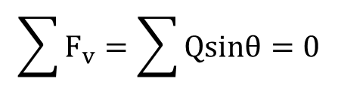
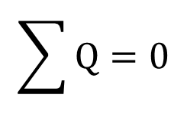
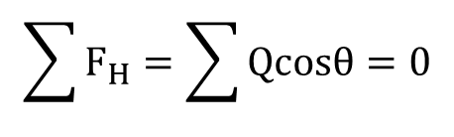
Spencer’s Method
For overall force equilibrium:
$$\sum{F_{v}}=\sum{Qsinθ=0}$$
$$\sum{F_{H}}=\sum{Qcosθ=0}$$
Since θ = constant, both simplify to:
$$\sum{Q=0}$$

Slide 39
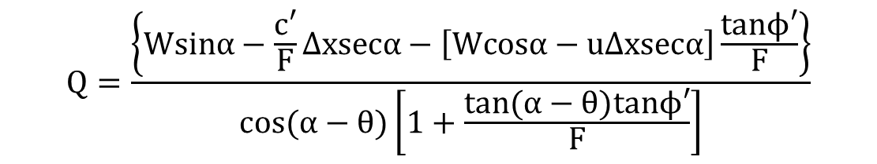
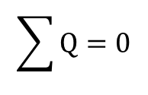
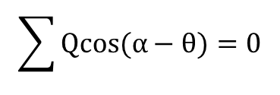
Spencer’s Method
By summing forces on individual slices, you can derive equation for Q in terms of known quantities:
$$Q=\frac{\left\{Wsinα−\frac{c′}{F}Δxsecα−\left[Wcosα−uΔxsecα\right]\frac{tanϕ′}{F}\right\}}{cos(α−θ)\left[1+\frac{tan(α−θ)tanϕ′}{F}\right]}$$
Now we have two equations:
$$\sum{Qcos(α−θ)=0}$$
$$\sum{Q=0}$$
Once again, equations must be solved iteratively.
And two unknowns:
F and θ

Slide 40
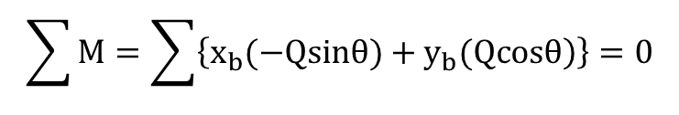
Spencer’s Method
Non-circular surfaces:
Set up a coordinate system and sum moments about the origin
$$\sum{M}=\sum{\left\{\left.x_{b}(−Qsinθ)+y_{b}(Qcosθ\right)\right\}=0}$$
Once again, we have two equations and two unknowns.

Slide 41

Morgenstern & Price Method
Interslice shear force is related to interslice normal force by:
$$X=λf(x)E$$
λ = unknown scaling factor
f(x) = assumed function
The normal force N acts at the base of the slice
Satisfies complete equilibrium
More work than Spencer’s method, but gives about the same results

Slide 42

Chen & Morgenstern’s Method
Improvement to M&P method.
Interslice shear force is related to interslice normal force by:
$$X=\left[\left.λf(x)+f_{o}(x\right)\right]E$$
Equation is thought to better represent side force relationship at ends
Satisfies complete equilibrium

Slide 43

Sarma’s Procedure
Similar to M&P and C&M methods
Interslice shear force is related to shear strength as follows:
$$X=λf(x)S_{v}$$
Developed for applications in seismic stability and includes seismic coefficient
Satisfies complete equilibrium

Slide 44
Comparison of Methods
See tables 6.2 and 6.3 in text
Spencer’s method is often the preferred method
Accurate
Simplest complete equilibrium method
Can be used for circular or non-circular surfaces

